Slide 1
Search Strategies

Slide 2
An uninformed search is a searching technique that has no additional information about the distance from the current state to the goal.
Informed Search is another technique that has additional information about the estimate distance from the current state to the goal. Uses knowledge to find the steps to the solution.

Slide 3
Uninformed vs. Informed Search
Uninformed Search Strategies
Breadth-First search
Depth-First search
Uniform-Cost search
Depth-First Iterative Deepening search
Informed Search Strategies
Hill climbing
Best-first search
Greedy Search
Beam search
Algorithm A
Algorithm A*

Slide 4
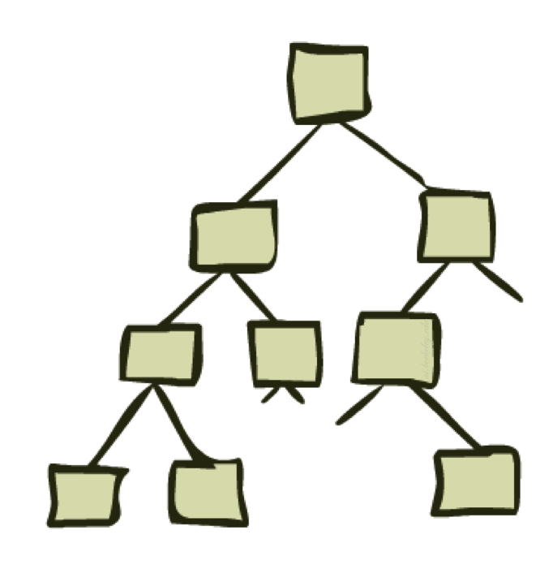
Uninformed Search
Depth First Search and its Variants

Slide 5
Breadth-First
Algorithm outline:
Always select node from the Frontier at smallest depth for expansion, and put all newly generated nodes into Explored
Explored is organized as FIFO (first-in, first-out) list, i.e., a queue.
Terminate if a node selected for expansion is a goal
Properties
Complete (finds all the possible outcomes of a problem.)
Optimal (find the least cost outcome for a problem)
(i.e., admissible) if all operators have the same cost. Otherwise, not optimal but finds solution with shortest path length (shallowest solution).
Exponential time and space complexity,
O(b^{d}) nodes will be generated, where
d is the depth of the solution and
b is the branching factor (i.e., number of children) at each node

Slide 6
Breadth-First
s
A complete search tree of depth d where each non-leaf node has b children, has a total of
1 + b + b^2 + ... + b^d = (b^(d+1) - 1)/(b-1) nodes
Time complexity (# of nodes generated): O(b^d)
Space complexity (maximum length of Frontier): O(b^d)
1
1
b
2
b^2
d
b^d
For a complete search tree of depth 12, where every node at depths 0, ..., 11 has 10 children
every node at depth 12 has 0 children,
there are 1 + 10 + 100 + 1000 + ... + 10^12 = (10^13 - 1)/9 = O(10^12) nodes in the complete search tree.
BFS is suitable for problems with shallow solutions

Slide 7
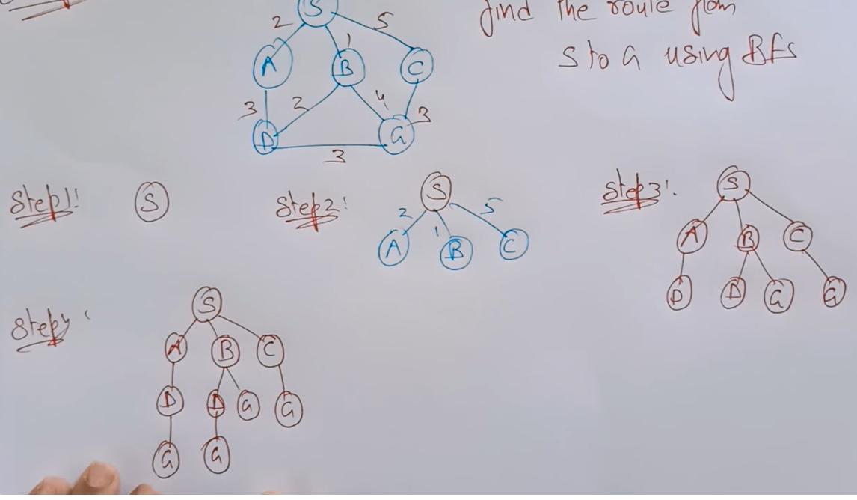

Slide 8
Example Illustrating Uninformed Search Strategies
S
1
8
5
A
B
C
3
9
7
4
5
D
E
G

Slide 9
S
1
8
5
A
B
C
3
9
7
4
5
D
E
G
G’
G”

Slide 10
Depth-First (DFS)
Algorithm outline:
Always select Frontier the node with the greatest depth for expansion, and put all newly generated nodes into OPEN
Expand is organized as LIFO (last-in, first-out) list.
Terminate if a node selected for expansion is a goal
goal
May not terminate without a "depth bound," i.e., cutting off search below a fixed depth D (How to determine the depth bound?)
Not complete (with or without cycle detection, and with or without a cutoff depth)
Exponential time, O(b^d), but only linear space, O(bd), required
Can find deep solutions quickly if lucky
When search hits a deadend, can only back up one level at a time even if the "problem" occurs because of a bad operator choice near the top of the tree. Hence, only does "chronological backtracking"

Slide 11
Depth-First Search
Solution path found is S A G <-- this G has cost 10
Number of nodes expanded (including goal node) = 5
S
1
8
5
A
B
C
3
9
7
D
E
G

Slide 12
Depth-Limited Search (DLS)
DFS with a depth bound
Searching is not permitted beyond the depth bound.
Works well if we know what is the depth of the solution.
If the solution is beneath the depth bound, the search cannot find the goal (hence this search algorithm is incomplete).

Slide 13
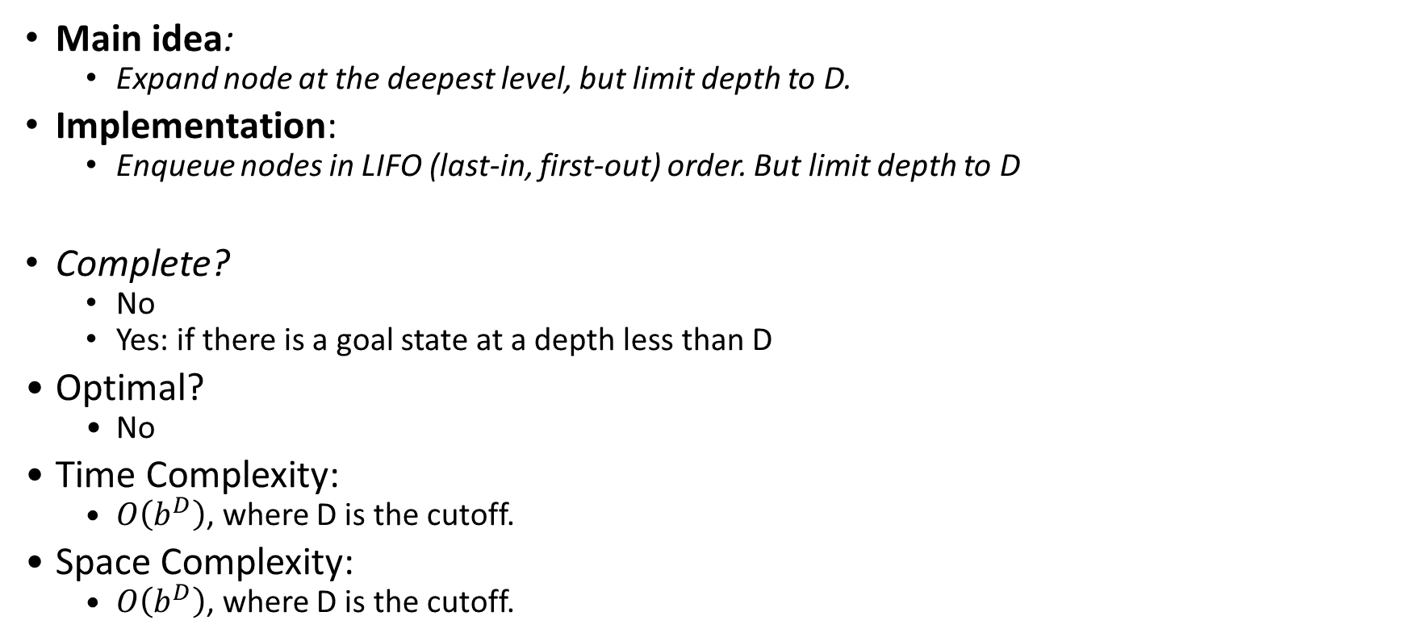
Depth-Limited Search (DLS)
Main idea:
Expand node at the deepest level, but limit depth to D.
Implementation:
Enqueue nodes in LIFO (last-in, first-out) order. But limit depth to D
Complete?
No
Yes: if there is a goal state at a depth less than D
Optimal?
No
Time Complexity:
$O\left(b^{D}\right)$, where D is the cutoff.
Space Complexity:
$O\left(b^{D}\right)$, where D is the cutoff.

Slide 14
Iterative Deepening Search
To avoid the infinite depth problem of DFS:
Only search until depth L
i.e, don’t expand nodes beyond depth L
Depth-Limited Search
What if solution is deeper than L?
Increase depth iteratively
Iterative Deepening Search (IDS)
IDS
Inherits the memory advantage of depth-first search
Has the completeness property of breadth-first search

Slide 15
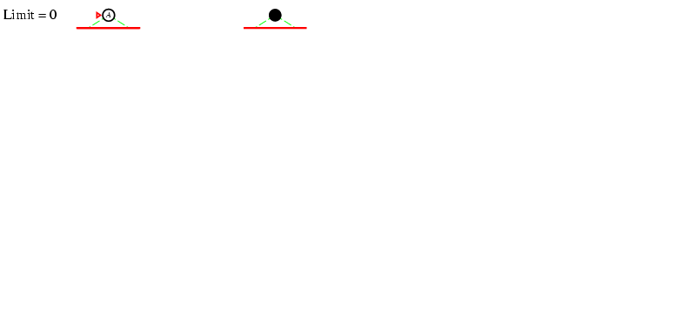
Iterative deepening search l =0
15

Slide 16
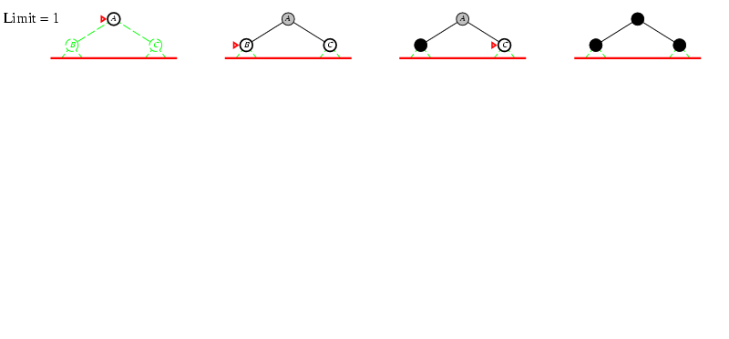
Iterative deepening search l =1
16

Slide 17
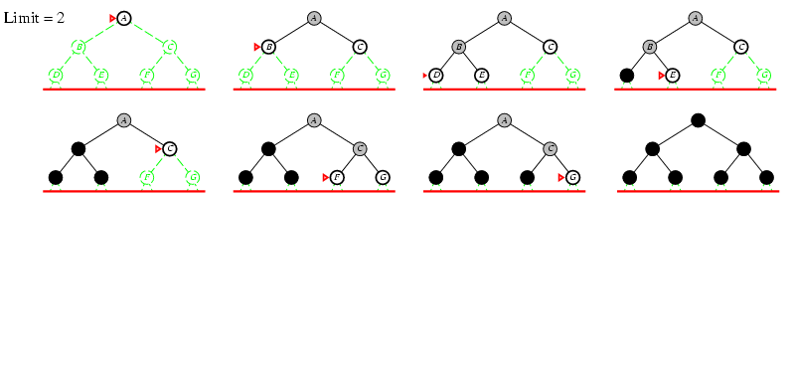
Iterative deepening search l =2
17

Slide 18
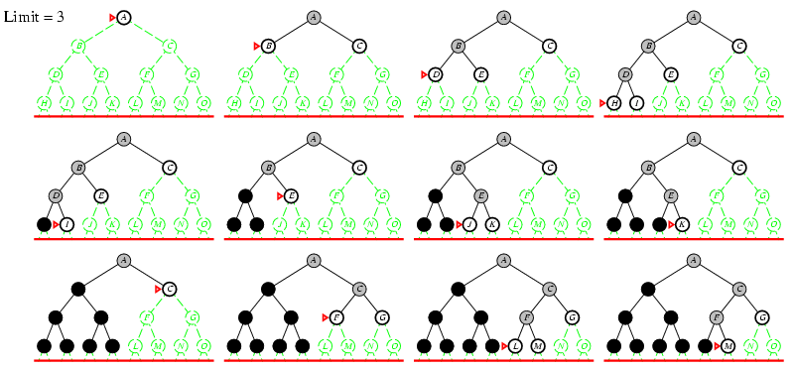
Iterative deepening search l =3
18

Slide 19
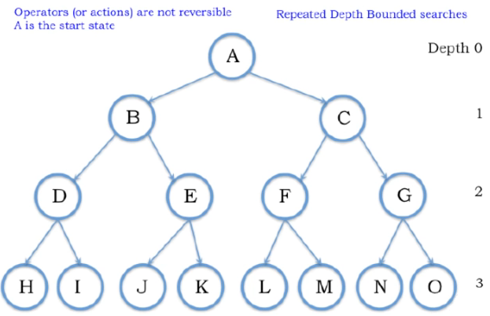

Slide 20
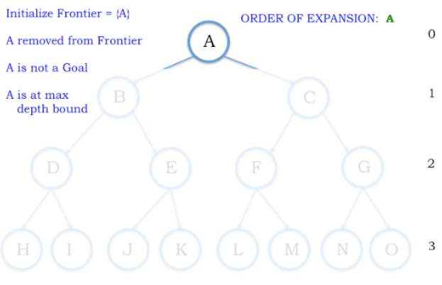
Depth Bound = 0

Slide 21
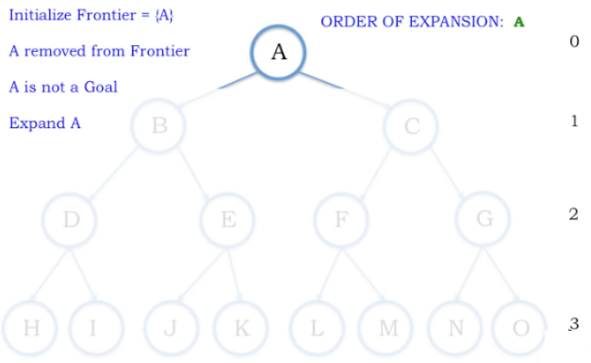
Depth Bound = 1

Slide 22
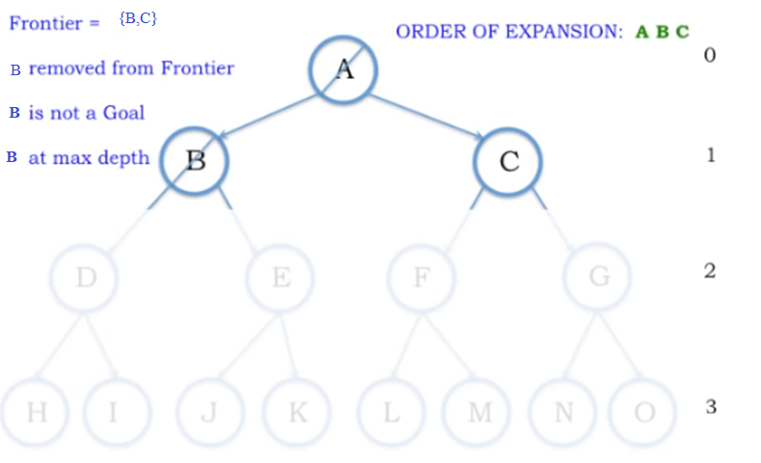
Depth Bound = 1

Slide 23
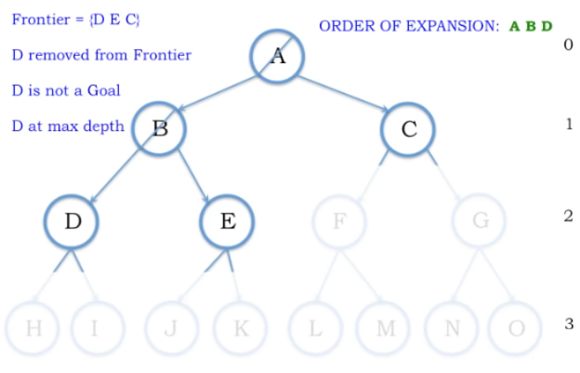

Slide 24
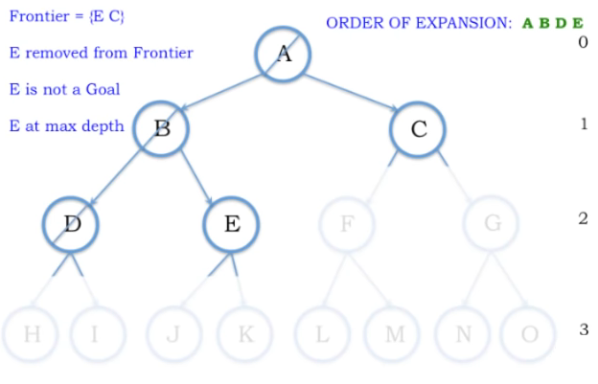

Slide 25
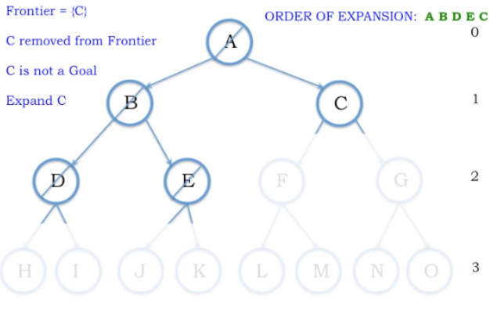

Slide 26
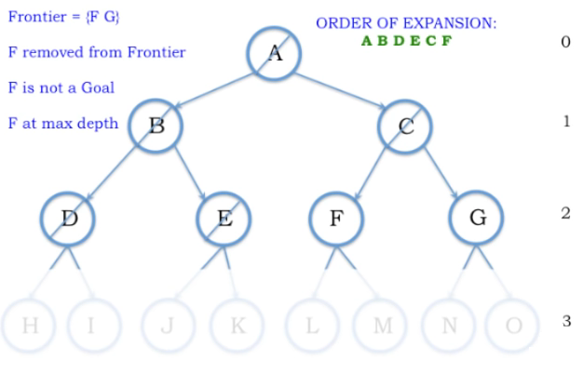

Slide 27
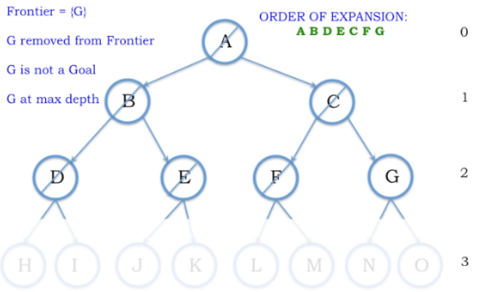
Depth 2

Slide 28
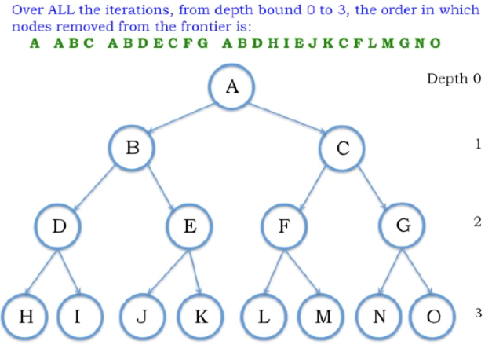

Slide 29
Properties of Iterative Deepening Search
Complete? Yes (in finite spaces)
Time? O(b^{d})
Space? O(bd)
Optimal? Yes, (if step cost = 1 i.e. identical step cost)
29

Slide 30
Activity
Iterative deepening search l =3
A
D
B
Do it on notebook
Start Node: A
Goal Node: G
Step Frontier Expand[*] Explored: a set of nodes
F
E
C
G
B
G
E

Slide 31
Iterative Deepening Search
Idea: get DFS’s space advantage with BFS’s time / shallow-solution advantages
Run a DFS with depth limit 1. If no solution…
Run a DFS with depth limit 2. If no solution…
Run a DFS with depth limit 3. …..
Isn’t that wastefully redundant?
Generally most work happens in the lowest level searched, so not so bad!
b
…

Slide 32
When to do goal test?
Do Goal-Test when node is popped from queue
IF you care about finding the optimal path
AND your search space may have both short expensive and long cheap paths to a goal.
Guard against a short expensive goal.
E.g., Uniform Cost search with variable step costs.
Otherwise, do Goal-Test when is node inserted.
E.g., Breadth-first Search, Depth-first Search, or Uniform Cost search when cost is a non-decreasing function of depth only (which is equivalent to Breadth-first Search).
REASON ABOUT your search space & problem.
How could I possibly find a non-optimal goal?

Slide 33
When to do Goal-Test? Summary
For DFS, BFS, DSL (domain specific language) and IDS (Iterative depth search), the goal test is done when the child node is generated.
These are not optimal searches in the general case.
BFS and IDS are optimal if cost is a function of depth only; then, optimal goals are also shallowest goals and so will be found first
For GBFS (goal based first) the behavior is the same whether the goal test is done when the node is generated or when it is removed
h(goal)=0 so any goal will be at the front of the queue anyway.
For UCS (uniform cost ) and A*(graph traversal algorithm) the goal test is done when the node is removed from the queue.
This precaution avoids finding a short expensive path before a long cheap path.

Slide 34
Cost-Sensitive Search
a
GOAL
2
2
b
c
3
2
1
8
2
e
d
f
3
9
8
2
START
h
1
4
2
p
4
r
15
q
BFS finds the shortest path in terms of number of actions.
It does not find the least-cost path. We will now cover
a similar algorithm which does find the least-cost path.

Slide 35
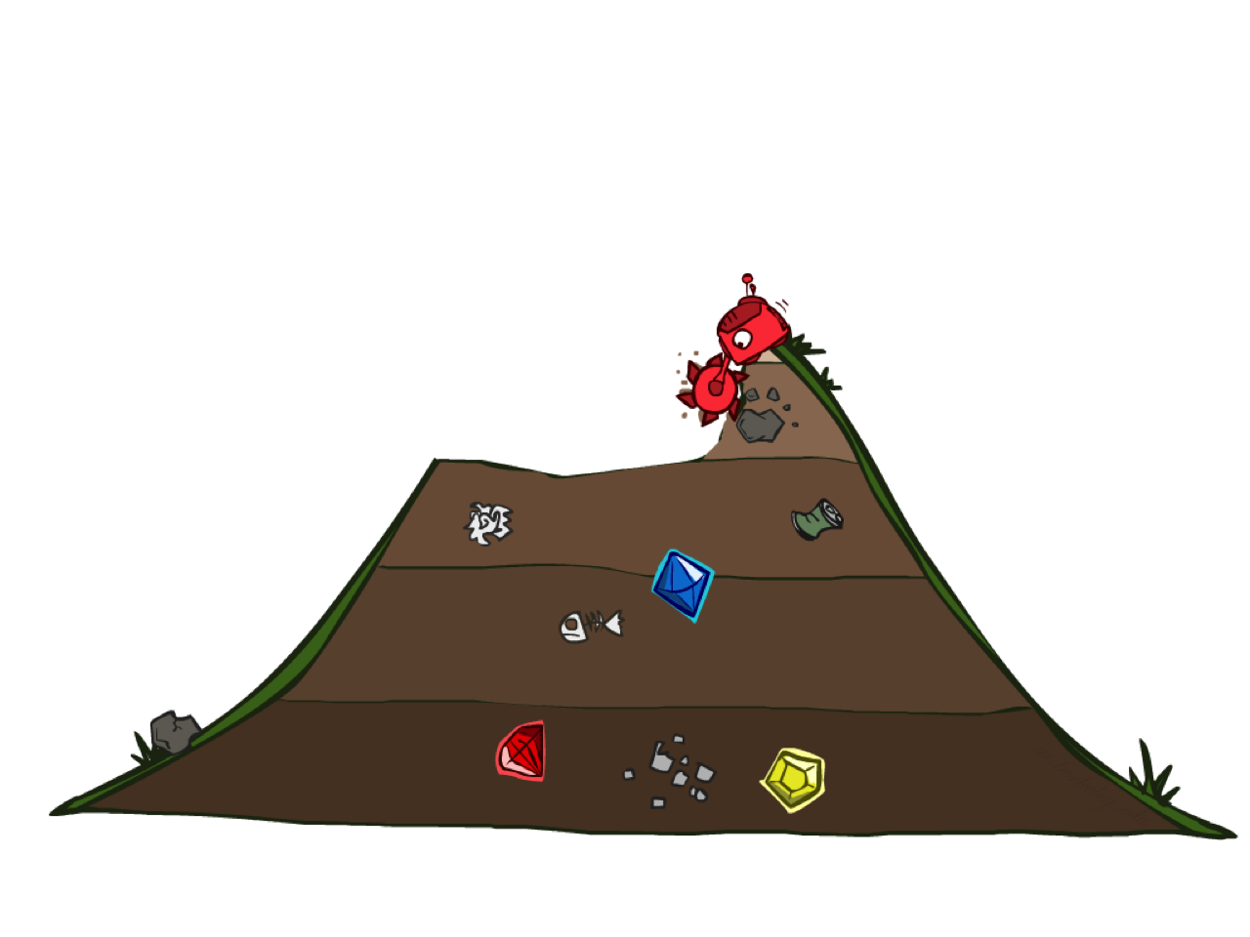
Uniform Cost Search

Slide 36
Uniform Cost Search
Breadth-First Search find the shallowest goal state, but this may not always be the least-cost solution.
Uniform-Cost Search modifies the Breadth-First Search strategy by always expanding the lowest path cost g(n) node on the fringe (outlier).
Frontier is a priority queue, i.e., new successors are merged into the queue sorted by g(n).
Can remove successors already on queue w/higher g(n).
Saves memory, costs time; another space-time trade-off.

Slide 37
Uniform Cost Search
2
G
a
Strategy: expand a cheapest node first:
Fringe is a priority queue (priority: cumulative cost)
b
c
1
8
2
2
e
3
d
f
9
8
2
S
15
h
1
1
p
q
r
0
S
d
3
e
9
p
1
b
4
e
5
h
17
r
11
q
56
c
11
Cost contours
a
6
a
h
13
r
7
p
q
f
p
q
f
8
q
c
G
q
c
a
11
G
10
a
Notes:
Like breadth first, but with costs. Label with cumulative cost.
Goal path not victory until try to expanded.
Contours show equal cost.

Slide 38
Uniform Cost Search (UCS)
A
5
2
[5]
B
C
[2]
1
4
1
7
D
[6]
[3]
F
G
[9]
[9]
E
Goal state
4
5
[x] = g(n)
path cost of node n
[7]
H
I
[8]

Slide 39
Uniform Cost Search (UCS)
A
5
2
[5]
B
C
[2]

Slide 40
Uniform Cost Search (UCS)
A
5
2
[5]
B
C
[2]
1
7
[3]
F
G
[9]

Slide 41
Uniform Cost Search (UCS)
A
5
2
[5]
B
C
[2]
1
7
[3]
F
G
[9]
4
5
[7]
H
I
[8]

Slide 42
Uniform Cost Search (UCS)
A
5
2
5
2
[2]
[5]
B
C
[2]
[5]
1
4
1
1
7
7
D
[6]
[3]
F
G
[9]
[3]
[9]
[9]
E
4
5
4
5
[7]
H
I
[8]
[7]
[8]

Slide 43
Uniform Cost Search (UCS)
A
5
2
5
5
2
2
[2]
[2]
[5]
B
C
[2]
[5]
[5]
Goal state path cost g(n)=[6]
1
1
4
1
4
1
1
7
7
7
D
[3]
F
G
[9]
[3]
[3]
[9]
[9]
[9]
[9]
E
4
5
4
4
5
5
[7]
H
I
[8]
[7]
[7]
[8]
[8]

Slide 44
Uniform Cost Search (UCS)
A
5
2
5
5
2
2
[2]
[2]
[5]
B
C
[2]
[5]
[5]
1
1
4
1
4
1
1
7
7
7
D
[6]
[3]
F
G
[9]
[6]
[3]
[3]
[9]
[9]
[9]
[9]
E
4
5
4
4
5
5
[7]
H
I
[8]
[7]
[7]
[8]
[8]

Slide 45
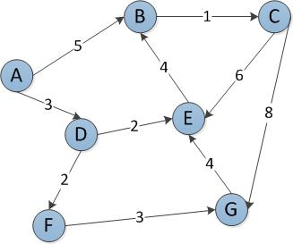
Start Node: A
Goal Node: G
Step Frontier Expand[*] Explored: a set of nodes
1 {(A,0)} A ∅
2 {(A-D,3),(A-B,5)} D {A}
3 {(A-B,5),(A-D-E,5),(A-D-F,5)} B {A,D}
4 {(A-D-E,5),(A-D-F,5),(A-B-C,6)} E {A,D,B}
5 {(A-D-F,5),(A-B-C,6)}[*] F {A,D,B,E}
6 {(A-B-C,6),(A-D-F-G,8)} C {A,D,B,E,F}
7 {(A-D-F-G,8),(A-B-C-E,12} G {A,D,B,E,F,C}
8 ∅
Found the path: A -> D -> F -> G.
*B is not added to the frontier because it is found in the explored set.

Slide 46
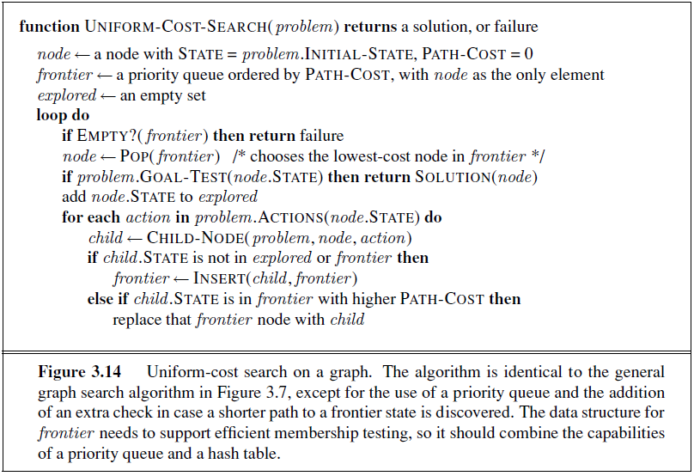
Uniform Cost Search

Slide 47
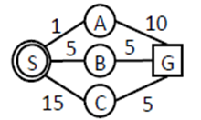
Uniform Cost Search

Slide 48
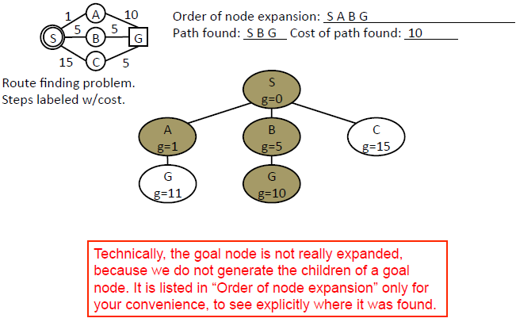
Uniform Cost Search

Slide 49
Uniform Cost Search (UCS) Properties
What nodes does UCS expand?
Processes all nodes with cost less than cheapest solution!
If that solution costs C* and arcs cost at least ε , then the “effective depth” is roughly C*/ε
Takes time O(b^{C*/ε}) (exponential in effective depth)
How much space does the fringe take?
Has roughly the last tier, so O(b^{C*/ε})
Is it complete?
Assuming best solution has a finite cost and minimum arc cost is positive, yes!
Is it optimal?
Yes! (Proof next lecture via A*)
b
c ≤ 1
…
C*/ε “tiers”
c ≤ 2
c ≤ 3

Slide 50
Uniform Cost Issues
…
c ≤ 1
Remember: UCS explores increasing cost contours
The good: UCS is complete and optimal!
The bad:
Explores options in every “direction”
No information about goal location
We’ll fix that soon!
c ≤ 2
c ≤ 3
Start
Goal

Slide 51
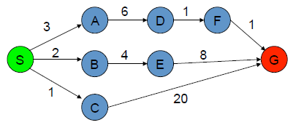
Uniform Cost Search (Activity 1)
The graph above shows the step-costs for different paths going from the start (S) to the goal (G).
Use uniform cost search to find the optimal path to the goal.
Step | Frontier | Expand | Explored
1
2

Slide 52
 | Frontier | Expand | Explored
1 | S | S | Empty
2 | (S-C,1) (S-B,2)(S-A,3) | C | S
3 | (S-B,2)(S-A,3)(S-C-G,21) | B | S,C
4 | (S-A,3)(S-C-G,21)(S-B-E,6) | A | S,C,B
5 | (S-C-G,21)(S-B-E,6)(S-A-D,9) | E | S,C,B,A
6 | (S-C-G,21) (S-A-D,9) (S-B-E-G,14) | D | S,C,B,A,E
7 | (S-C-G,21) (S-B-E-G,14) (S-A-D-F,10) | F | S,C,B,A,E,D
8 | (S-C-G,21) (S-B-E-G,14) (S-A-D-F-G,11)
9 | S-A-D-F-G,11 Goal Found |  | S,C,B,A,E,D,F,G

Slide 53
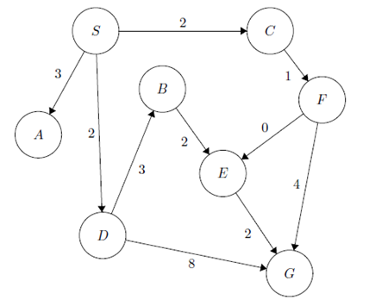
Activity 2
Step | Frontier | Expand | Explored: a set of Nodes
1 | (S,0) | S | Ø
2 | (S-C,2) (S-D,2) (S-A,3) | C | S
3 | (S-D,2) (S-A,3)(S-C-F,3) | D | S,C
4 | (S-A,3)(S-C-F,3)(S-D-B,5)(S-D-G,10) | A | S,C,D
5 | (S-C-F,3)(S-D-B,5)(S-D-G,10) | F | S,C,D,A
6 | (S-D-B,5)(S-D-G,10)(S-C-F-E,3)(S-C-F-G,7) | E | S,C,D,A,F
7 | (S-D-B,5)(S-D-G,10) (S-C-F-G,7) (S-C-F-E-G,5) | B | S,C,D,A,F,E
8 | (S-D-G,10) (S-C-F-G,7) (S-C-F-E-G,5)(S-D-B-E,7) | G | S,C,D,A,F,E,B
9 | (S-C-F-E-G,5) Goal Found

Slide 54
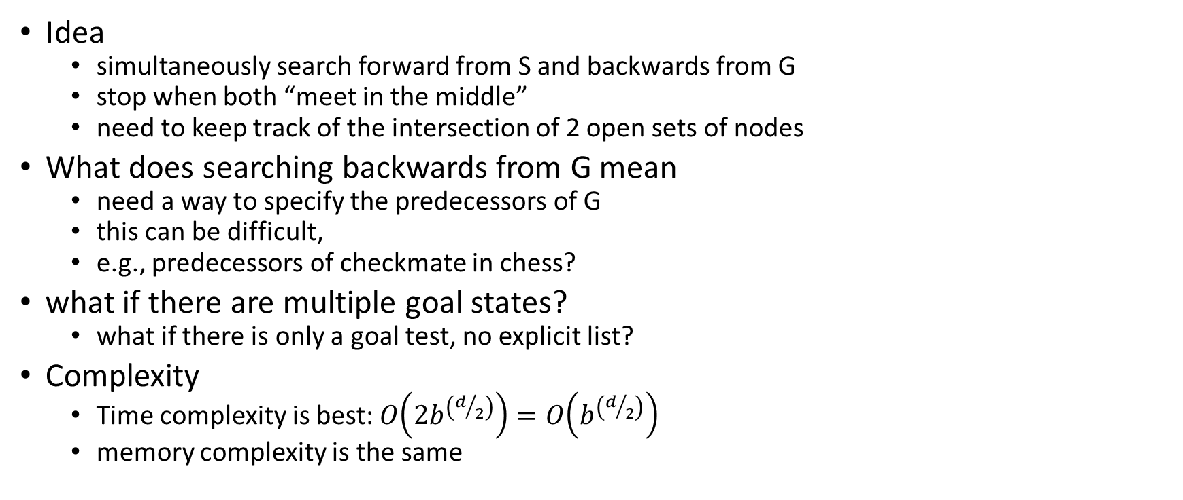
Bidirectional Search
Idea
simultaneously search forward from S and backwards from G
stop when both “meet in the middle”
need to keep track of the intersection of 2 open sets of nodes
What does searching backwards from G mean
need a way to specify the predecessors of G
this can be difficult,
e.g., predecessors of checkmate in chess?
what if there are multiple goal states?
what if there is only a goal test, no explicit list?
Complexity
Time complexity is best: $O\left(2b^{\left(d/2\right)}\right)=O\left(b^{\left(d/2\right)}\right)$
memory complexity is the same

Slide 55
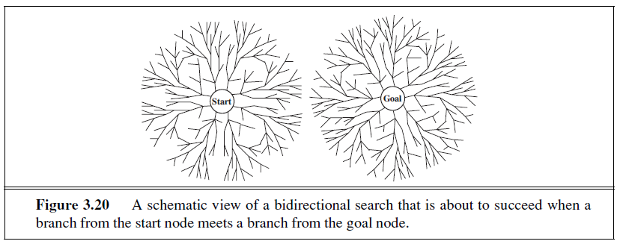
Bidirectional Search

Slide 56
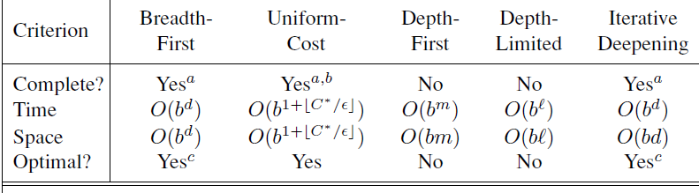
Summary of Algorithms
b branching factor
d depth of the shallowest solution
m maximum depth of the search tree
l depth limit
Superscripts:
a complete if b is finite
b complete if step costs ≥ epsilon for +ve epsilon
c optimal if step costs are all identical
56

Slide 57
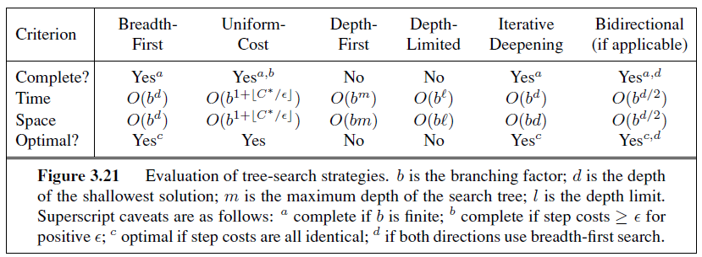
Summary of Algorithms

